Slide 1
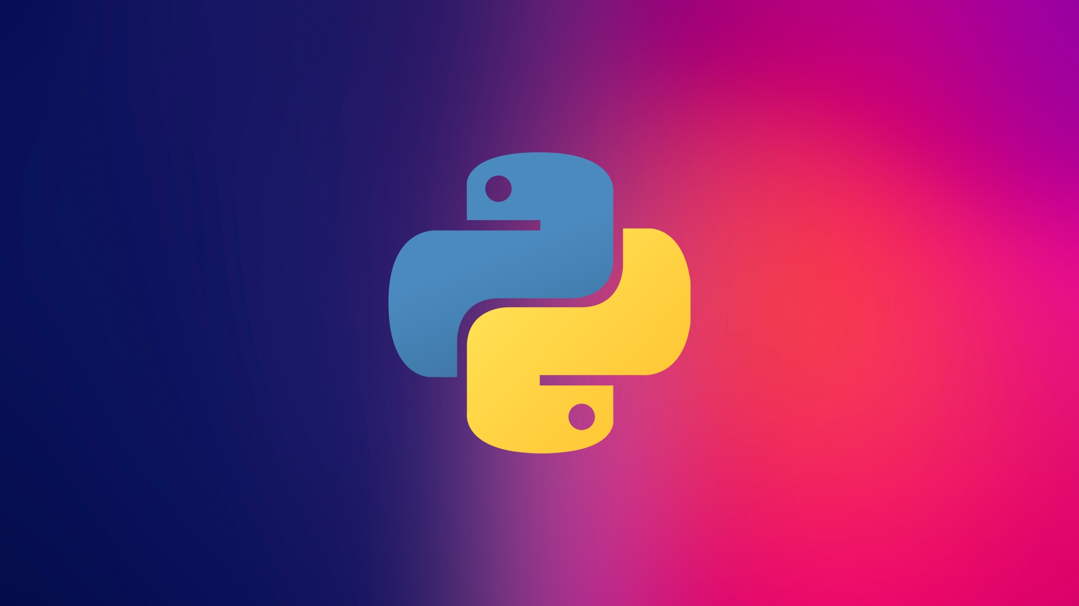

Slide 2
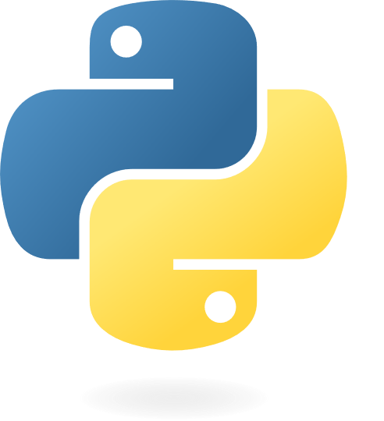
Python Programming Essentials
A.Asgharpoor
Fall 2023

Slide 3

Preliminaries

Slide 4

What is GitHub?
Web-based version control platform
Facilitates collaborative software development
Key Features
Version control: Track changes in code
Collaboration: Multiple contributors work on projects
Branching: Create parallel versions for development and testing
Significance in Programming Essentials
Essential for managing and sharing code
Industry-standard platform for open-source collaboration

Slide 5

What is Kaggle?
Data science and machine learning platform
Community of data scientists, researchers, and practitioners
Key Features
Datasets: Access to diverse datasets for analysis
Kernels: Interactive coding environments for data exploration
Competitions: Hosts machine learning competitions
Notebooks: Collaborative environment for sharing code and insights
Significance in Programming Essentials
Real-world data analysis and machine learning practice
Community-driven learning and collaboration platform

Slide 6

Jupyter Notebooks (ipynb)
What is ipynb?
File format for Jupyter Notebooks
Jupyter Notebooks
Interactive computing environments
Supports various programming languages (e.g., Python, R, Julia)
Components of ipynb
Text cells (Markdown): Documentation and explanations
Code cells: Executable code snippets
Usage in Programming Essentials
Ideal for data exploration, analysis, and code demonstration
Commonly used in data science and education

Slide 7
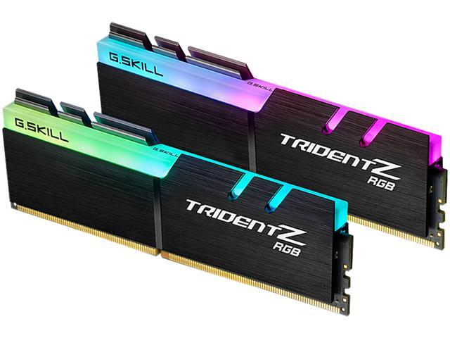
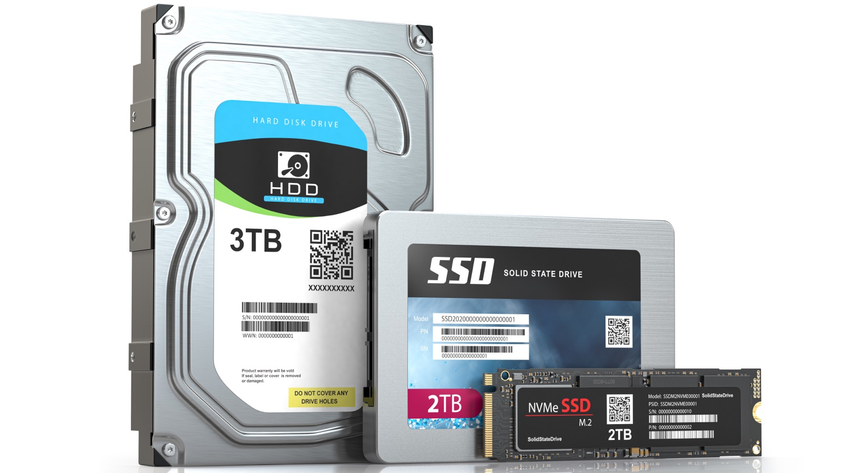
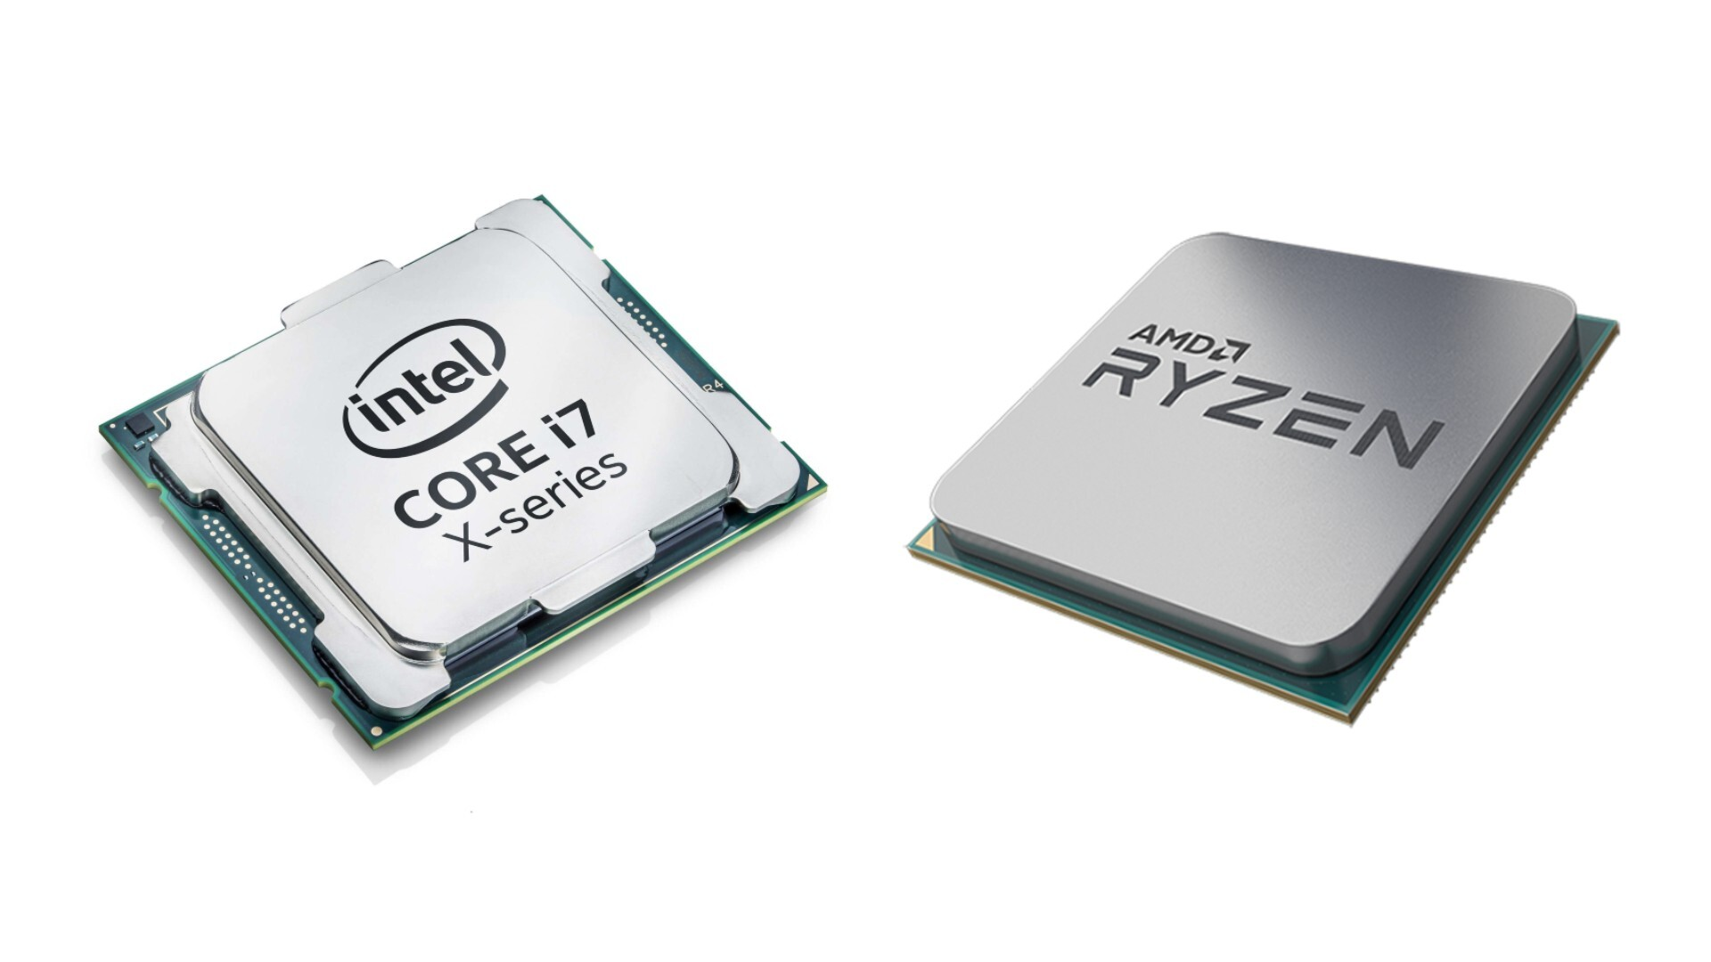
Hardware
CPU (Central Processing Unit)
The brain of the computer, responsible for executing instructions.
Memory (RAM)
Storage (HDD/SSD)
Input/output devices (keyboard, monitor)

Slide 8
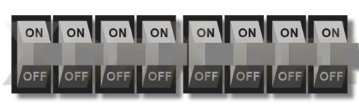
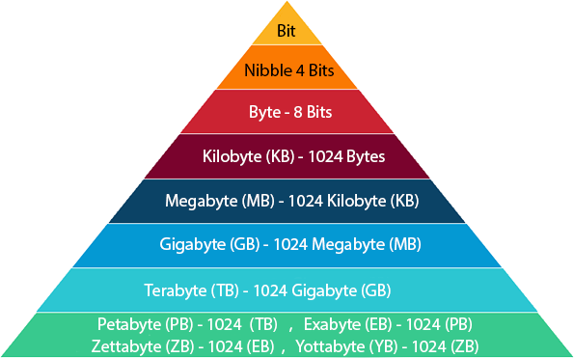
Bits and Bytes
The smallest information stored in the computer
Electric charge: High or Low
Binary system: 0 or 1
Bit (Binary Digit) - b
The basic building blocks of information
Byte - B
A group of 8 bits, represent 256 different values
Can represent a character using ASCII or Unicode encoding
Notes:
1. Bit (Binary Digit):
- A "bit" is the smallest unit of data in computing.
- It can have one of two values: 0 or 1, which represent the binary system.
- Bits are often used to represent the basic building blocks of information in a computer's memory or storage.
For example, a bit can represent the on/off state of an electrical circuit, with "0" indicating off and "1" indicating on. Bits are the foundation of all digital data representation and processing, from text and images to the complex operations performed by computers.
2. Byte:
- A "byte" is a group of 8 bits.
- It is the most common unit of data representation in computing.
- Bytes are used to store and represent various types of data, such as characters, numbers, and more.
Bytes provide a more practical and versatile way to represent information because they can encode a wider range of values. In many programming languages, a byte can represent a character (e.g., a letter, number, or symbol) using ASCII or Unicode encoding.
Here are a few important points about bytes:
- Bytes can represent 256 different values (2^8), ranging from 0 to 255.
- They can encode alphanumeric characters, control characters, and symbols, depending on the character encoding used.
- Bytes are used to measure the size of data in files, memory, and storage devices (e.g., a 1 KB file is 1024 bytes).
In addition to bytes, there are other data size units, including kilobytes (KB), megabytes (MB), gigabytes (GB), terabytes (TB), and more, which are formed by multiplying the basic byte unit by powers of 1024. These larger units are commonly used for measuring file sizes and storage capacities.
Understanding bits and bytes is essential in computer science and programming, as they underpin the representation and manipulation of data in digital systems.

Slide 9

Coding

Slide 10

Coding
A sequence of instructions to perform a specified task
Sequence of instructions
Computer Programming Language
High-Level Languages:
designed for human
Low-Level Languages:
closer to machine code and provide more direct control over hardware

Slide 11
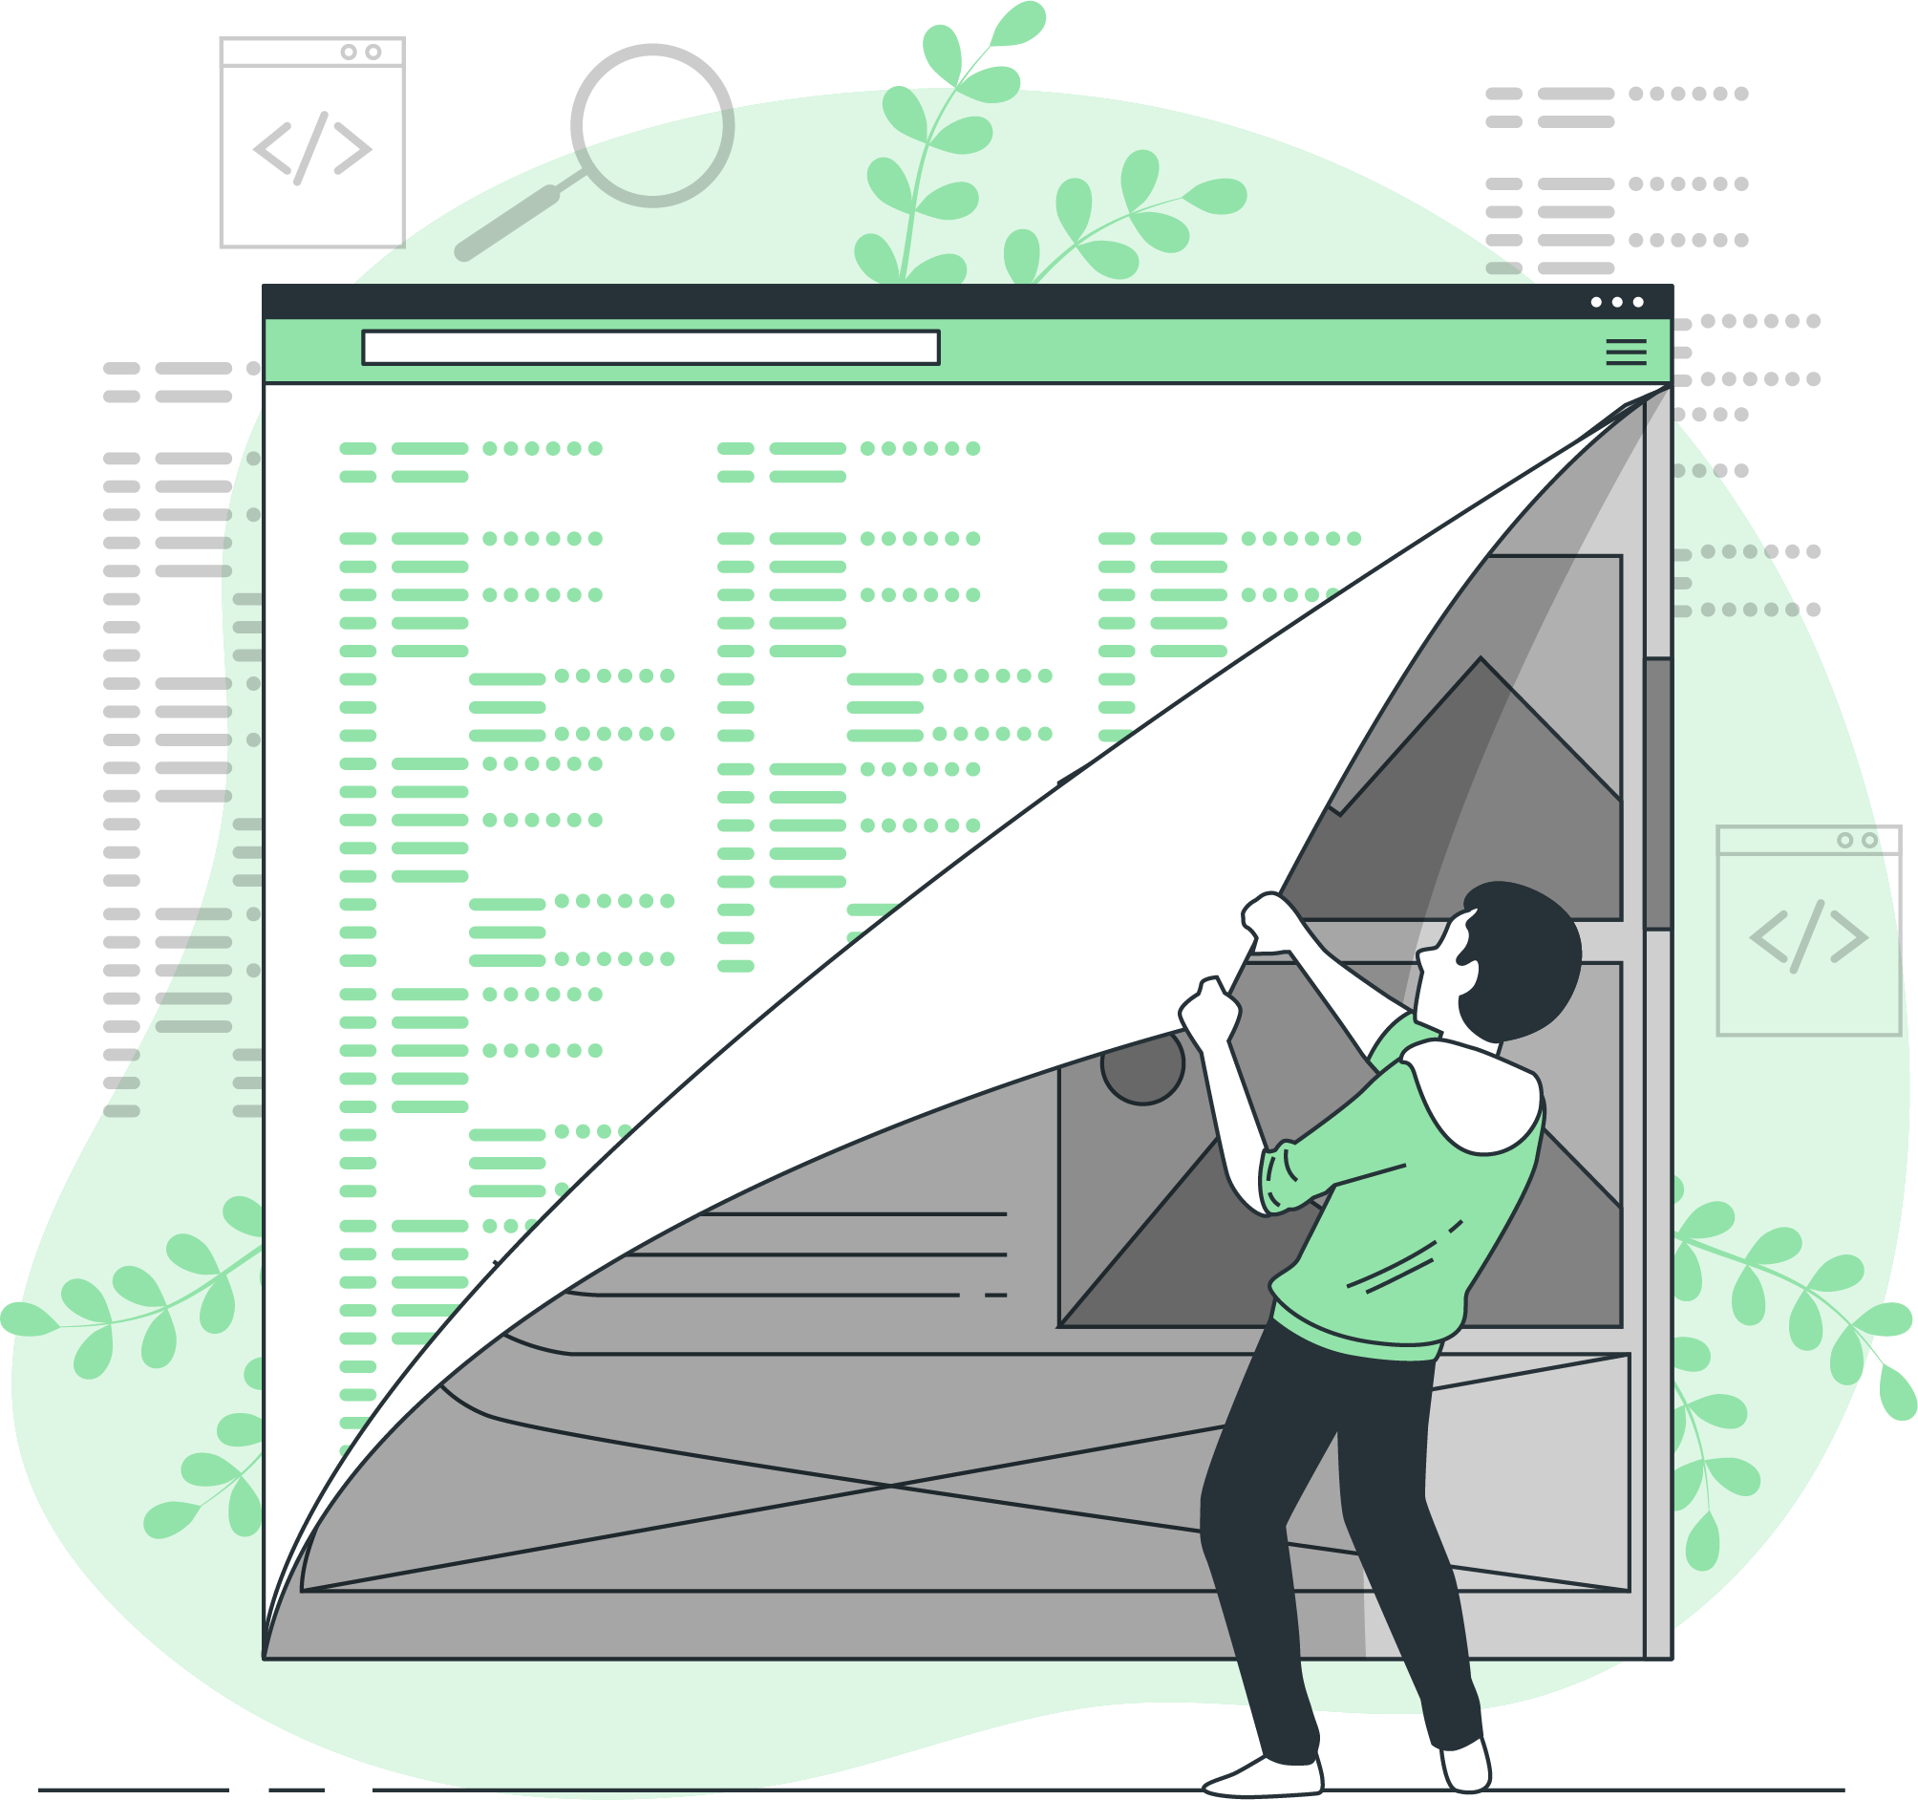
How Programming Languages Work
Source Code:
The sequence of instructions in a program
Compilation or Interpretation:
compiled into machine code or interpreted and executed line by line
Execution:
executed by the computer's processor.
Output:
may produce output
Code
Interpreter
Computer

Slide 12
How Programming Languages Work
Compiler translates the program into machine code before execution
Interpreter translates the program line by line as it is executed
slower to execute, but it also makes them faster to develop
The core concepts: the building blocks
Variables: store data
Data types: specify the type of data
Operators: perform operations
Expressions: combinations of variables, operators, and values
Control structures: control the flow of execution of a program
Functions: reusable blocks of code

Slide 13
Key Concepts
Syntax: specific syntax or grammar that must be followed
Variables: Used to store and manipulate data.
Control Structures: Determine the flow of the program.
Functions/Methods: Encapsulate code for reuse.
Data Types: Define how data is stored and manipulated.
Objects and Classes: Allow code organization.
Libraries and Frameworks: Pre-built code for common tasks.
Debugging and Testing: Ensuring code correctness.

Slide 14
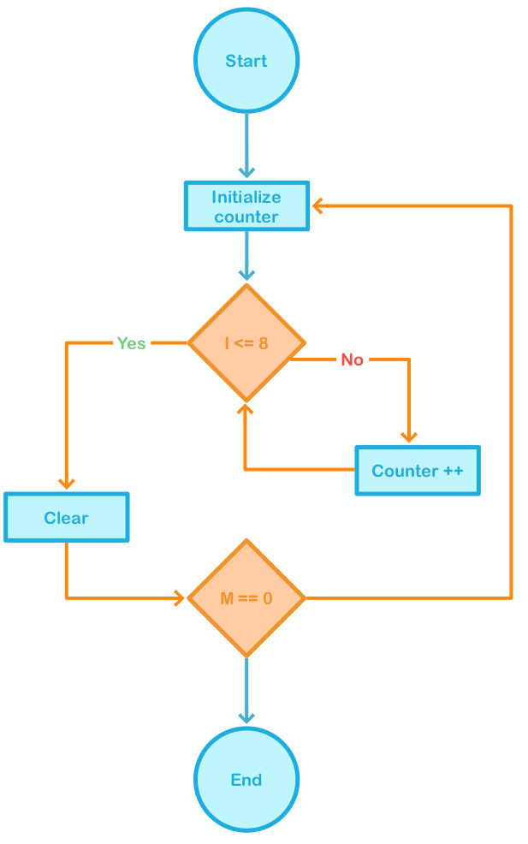


Understanding Algorithms
Foundation of programming
A step-by-step procedure
Solving a specific problem or performing a task

Slide 15


Slide 16
Variables and Data Types
Named storage location that holds data (values)
Can be changed during program execution
Value & Type
Integer (int):
Floating-Point (float):
Character (char):
String (str):
Boolean (bool):
whole numbers without decimal points.
numbers with decimal points.
a single character, such as a letter, number, or symbol.
a sequence of characters.
a binary value, either true or false.
List (list):
Tuple (tuple):
Dictionary (dict):
Set (set):
Null/None (NoneType):
an ordered collection of elements.
similar to a list but is immutable.
a collection of key-value pairs.
an unordered collection of unique elements.
the absence of a value.

Slide 17

Naming Variables
Must Start with a Letter or an Underscore (_)
Can Contain Letters, Digits, and Underscores
Are Case-Sensitive
Do Not Use Reserved Words or Keywords

Slide 18

Naming Conventions
Use Descriptive and Meaningful Names:
describe the purpose
Avoid Single-Letter Variable Names:
Except in Specific Cases
Single-letter variable names like x, y, or i should be avoided in most cases
Consistency
Meaningful Prefixes:
for Global/Class Variables

Slide 19
Keywords in Python
FALSE | await | else | import | pass
None | break | except | in | raise
TRUE | class | finally | is | return
and | continue | for | lambda | try
as | def | from | nonlocal | while
assert | del | global | not | with
async | elif | if | or | yield

Slide 20

Comments and Documentation
Used to annotate code and provide explanations
Not executed
Single-line comment: #
Multi-line comment or docstring: ''' '''

Slide 21
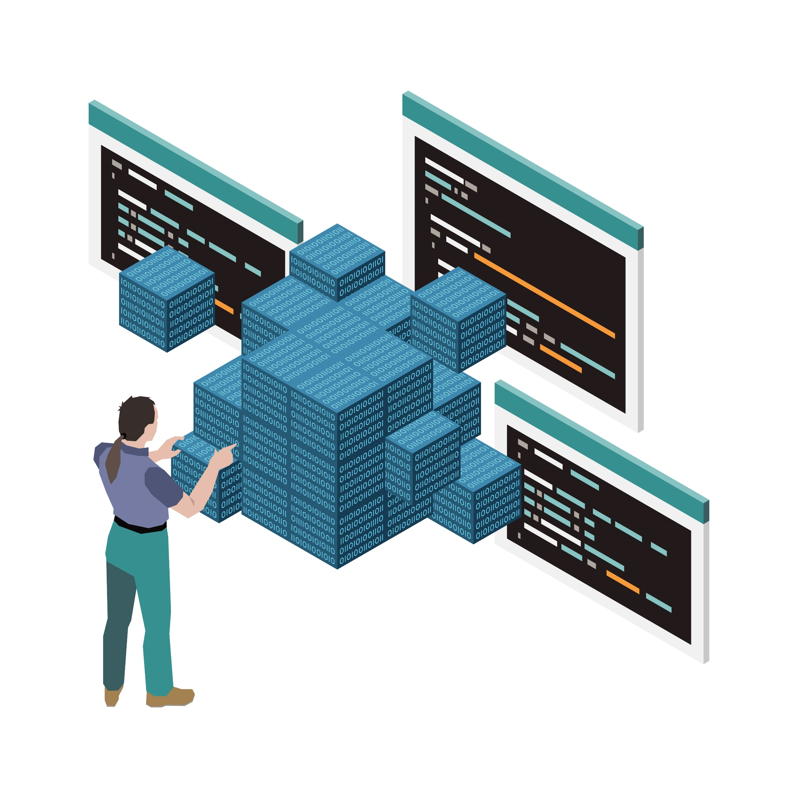
Indentation and Code Blocks
Define code blocks.
Crucial for structuring the code
Used in loops, conditionals, and functions.
Makes the code more readable
Helps Python understand the program's structure.

Slide 22
Indentation and Code Blocks
Code Block 1 Begins
Def abc():
....................
Code Block 2 Begins
For i in range(n):
....................
Code Block 3 Begins
if condition statement:
....................
Code Block 2 Continues
....................
Code Block 1 Continues
....................

Slide 23
Operators
Symbols or keywords used to perform operations
Arithmetic Operators:
Addition +
Subtraction -
Multiplication *
Division /
Modulus % (remainder after division)
Exponentiation **
Floor Division // (result rounded down to the nearest whole number)
Comparison Operators:
Equal ==
Not Equal !=
Greater Than >
Less Than <
Greater Than or Equal To >=
Less Than or Equal To <=
Logical Operators:
AND
OR
NOT

Slide 24
Assignment Operators
Assignment (=):
assigns the value on the right to the variable on the left.
Addition Assignment (+=)
Subtraction Assignment (-=)
Multiplication Assignment (*=)
Division Assignment (/=)
Modulus Assignment (%=)
Exponentiation Assignment (**=)
Floor Division Assignment (//=)

Slide 25
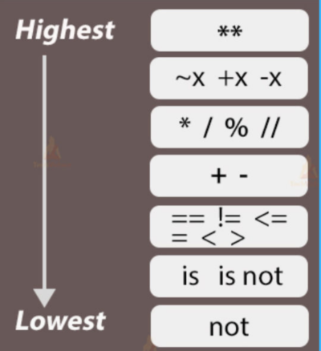
Operator Precedence
Operators have different levels of precedence
Parentheses: Expressions within parentheses are evaluated first
**: evaluated before other mathematical operations
*, /, //, and %: from left to right
+ and -: from left to right
Comparison: after arithmetic operations
Logical: after comparison operators
Assignment

Slide 26
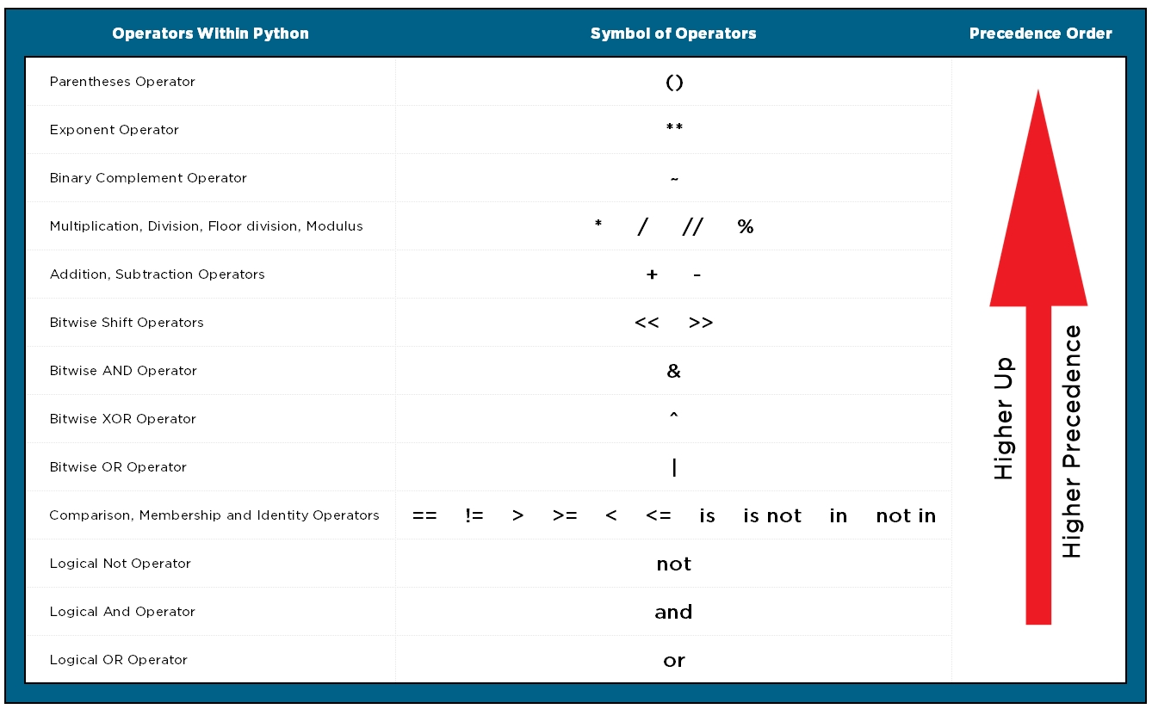

Slide 27

Input and Output
Allow programs to communicate with users and the outside world
Displaying Output: print()
User Input: input()

Slide 28
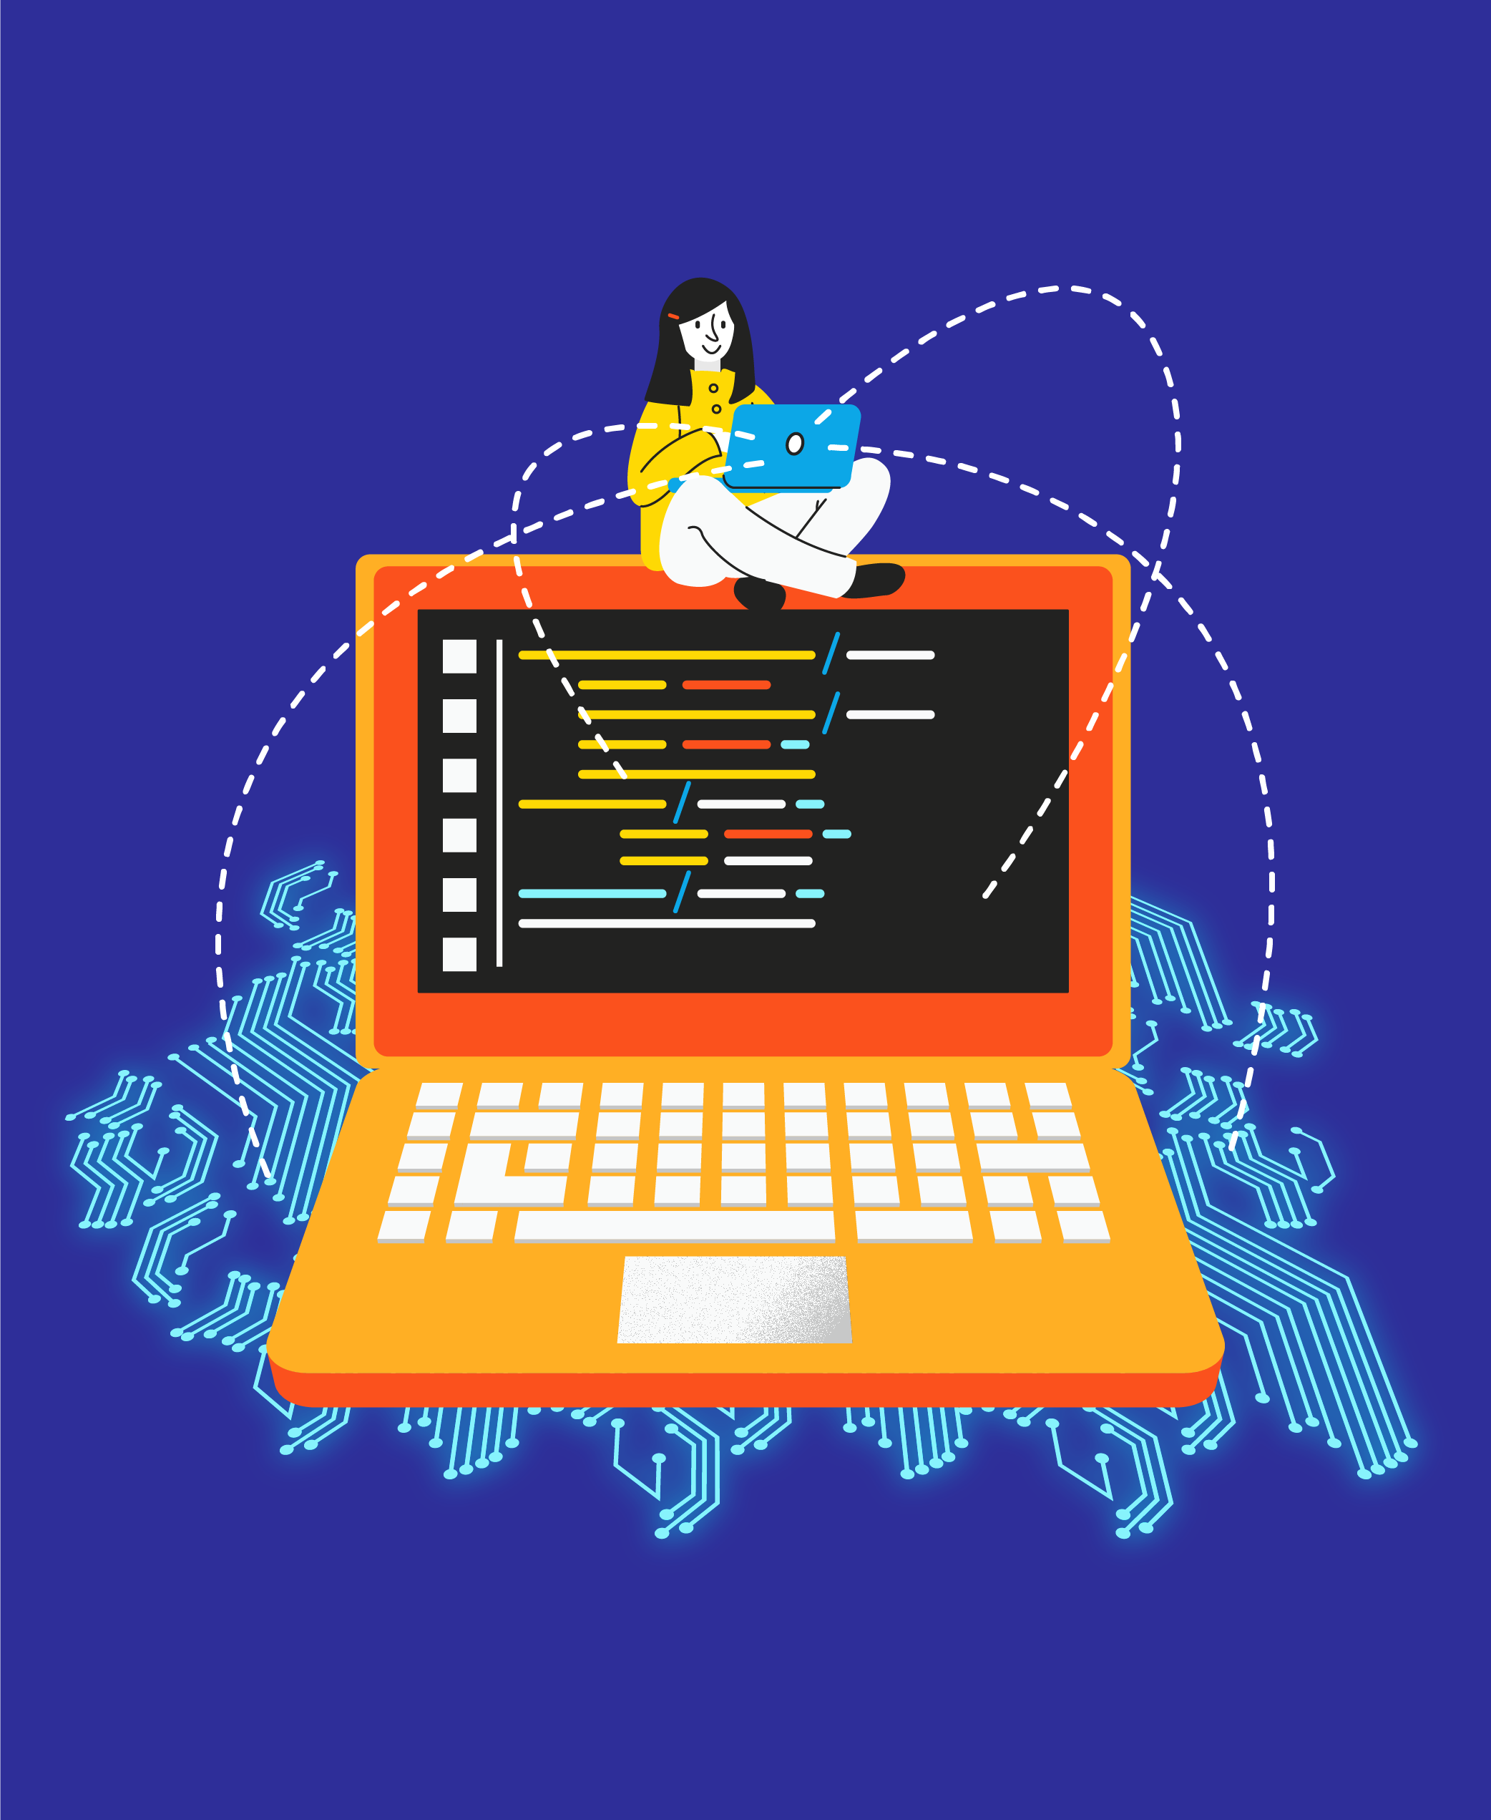
Formatting Output
String Formatting (f-strings):
allow to embed expressions inside string literals.
String Concatenation:
concatenate (combine) strings using +.
String Interpolation:
Using the .format() method to insert values into strings.

Slide 29
Control Flow and Logic
Determines the order in which statements are executed
Make decisions
Repeat actions
Manage the flow of the program
Conditional Statements: if, elif, else
Loops: for and while
Break and Continue Statements
Logical Operators: and, or, not
Comparison Operators

Slide 30


Data Structures
Organize and manage data
Lists
Tuples
Sets
Dictionaries

Slide 31
Mutability and Order
Mutability:
Modification after its creation
Mutable Data Structures:
Lists, dictionaries, and
Change their contents, add, remove, or update elements
Immutable Data Structures:
Strings and tuples
Cannot change their contents after creation.
Order:
Maintains the order of elements
Ordered Data Structures:
Lists and tuples
The order in which elements are added is preserved.
Unordered Data Structures:
Dictionaries and sets do not guarantee a specific order
The order may not match the order of insertion.

Slide 32
Iterable
Something you can loop over or iterate through
Key characteristics:
Sequenced: a sequence of elements.
Access by Index: elements can be accessed by index or position.
Iteration: can use a loop or iterator to access each element.
Common types:
Lists: iterate through each item using a for loop.
Strings: loop through each character in the string.
Tuples: sequences like lists but are immutable
Dictionaries: iterate over keys, values, or key-value pairs in dictionaries.
Sets: can loop through each item.
Generators: create iterables on the fly using functions or expressions.

Slide 33
Zip and Enumerate
Zip:
combining multiple iterables element-wise
creates pairs of elements from corresponding positions in the input iterables.
Enumerate:
used to iterate through elements of an iterable along with their indices
returns tuples with the index and the corresponding element

Slide 34
List Comprehensions
A concise and readable way to create lists
Compact and efficient
Applying an expression to each item in an iterable
Filtering the items based on a condition
new_list = [expression for item in iterable if condition]

Slide 35
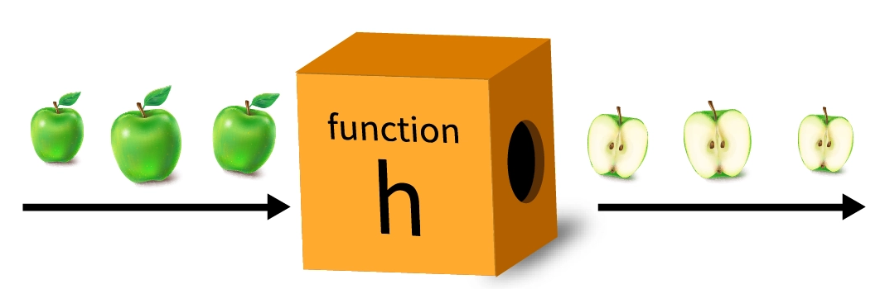
Functions
Reusable block of code
defined using the def keyword
Parameters: placeholders
Arguments: actual values passed to a function
Return Values
Local variables: are within a function's scope
Global variables: are accessible from anywhere in the code

Slide 36
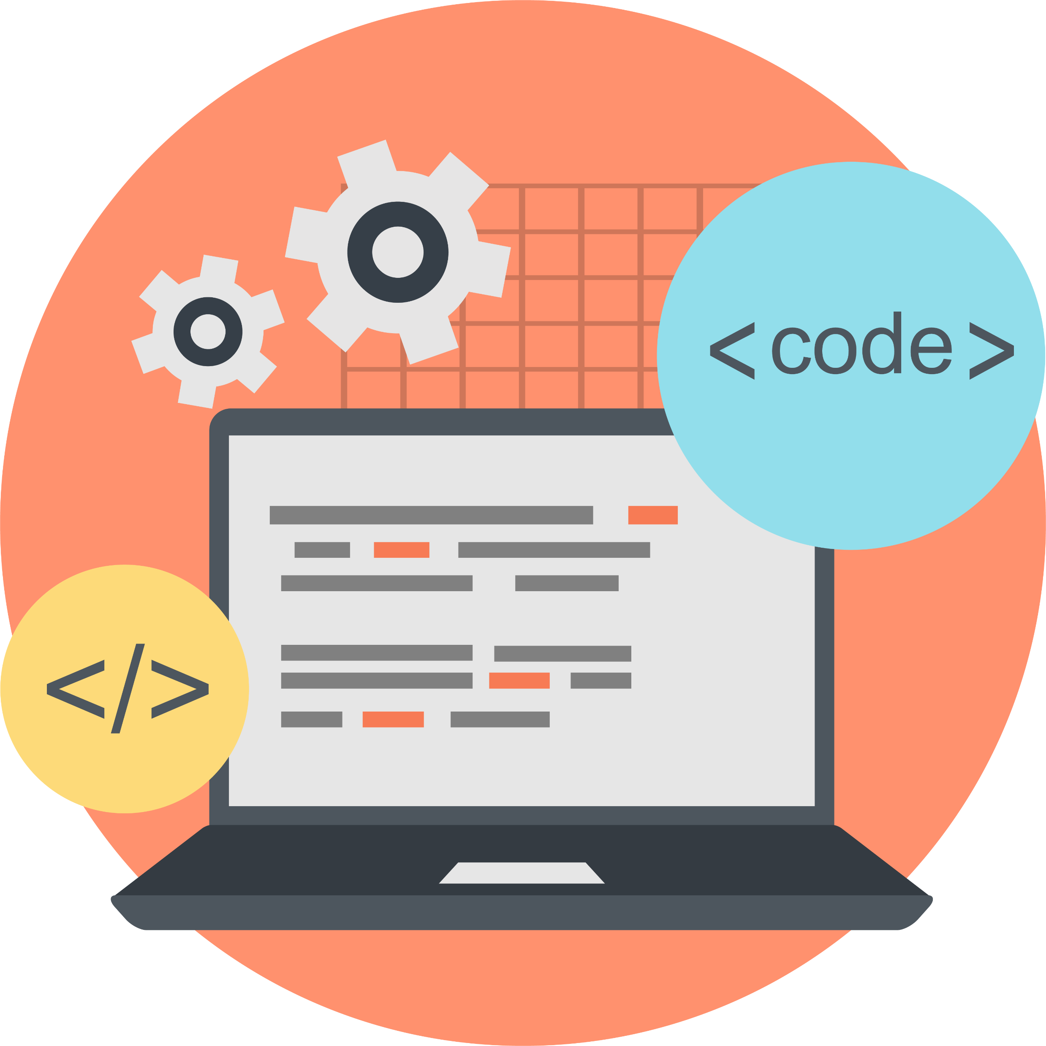
Functions
Lambda Functions
Small and anonymous functions
Used for short, simple operations
Variable-Length Arguments
Use *args and **kwargs
Accept a variable number of positional and keyword arguments
Nested Functions
Define inside other functions

Slide 37
Functions
Documentation (Docstrings)
include docstrings
describe a function's purpose, parameters, and return values

Slide 38
Functions
Syntax:
def name():
statement
statement
...
statement
Must be declared above the 'main' code
Statements inside the function must be indented

Slide 39
Modules
Reusable Python files containing code, variables, and functions
Organize and split the code into separate files
Used to import and reuse code across different programs

Slide 40

Introduction to File Handling
Read from and write to files
Common operations
reading, writing, creating, updating, and deleting files
Types of Files
text files: human-readable text
binary files: non-textual data (e.g., images, videos)

Slide 41
Opening a File
Opening a File `open()`
- Parameters:
- `'filename.ext'`: Name of the file
- `'mode'`: Specifies the file access mode
File Modes
- `'r'`: Read (default)
- `'w'`: Write (creates a new file or truncates existing)
- `'a'`: Append (opens for writing, appending to the end)
- `'b'`: Binary mode (e.g., `'rb'` for read binary)
Closing the File
- Always close the file using the `close()` method after operations

Slide 42


Python Library

Slide 43
Standard Library
What is the Standard Library?
Collection of modules and packages that come with Python
Key Features
Extensive set of modules for various functionalities
Part of the Python distribution, no separate installation needed
Promotes code reusability and efficiency

Slide 44
Standard Library
Commonly Used Modules
os: Operating system interfaces (e.g., file and directory operations)
datetime: Date and time-related functions
random: Generates pseudo-random numbers
math: Mathematical functions and constants
json : JSON encoding and decoding
Importing Modules
import ‘module_name’

Slide 45
Third-party library Useful Third-Party Packages
IPython - A better interactive Python interpreter
requests - Provides easy to use methods to make web requests.
Flask - A lightweight framework for making web applications and APIs.
Django - A more featureful framework for making web applications.
Beautiful Soup - Used to parse HTML and extract information from it.
pytest - extends Python's built-in assertions and unittest module.
PyYAML - For reading and writing YAML files.
Notes:
Being able to install and import third party libraries is useful, but to be an effective programmer you also need to know what libraries are available for you to use. People typically learn about useful new libraries from online recommendations or from colleagues. If you're a new Python programmer you may not have many colleagues, so to get you started here's a list of packages that are popular with engineers at Udacity.

Slide 46
Third-party library
NumPy - The fundamental package for scientific computing with Python.
pandas - Containing high-performance, data structures and data analysis tools.
Matplotlib - Plotting library to produce figures and interactive environments.
ggplot - Another 2D plotting library, based on R's ggplot2 library.
Pillow - Adds image processing capabilities to your Python interpreter.
pyglet - A cross-platform application framework intended for game development.
Pygame - A set of Python modules designed for writing games.

Slide 47

Object-Oriented Programming

Slide 48
Introduction to OOP
OOP is a programming paradigm.
Focuses on modeling real-world concepts using objects.
Key Concepts
Class
Blueprint or template for creating objects
Object
Instance of a class with its own unique data and behavior
Attributes
Characteristics or properties of an object
Methods
Actions or functions that objects can perform

Slide 49
Principles of OOP
Encapsulation
Bundling data and methods into a single unit (an object)
Abstraction
Representing complex reality while hiding unnecessary details
Inheritance
Creating new classes based on existing classes
Polymorphism
Objects of different classes can be treated as objects of a common superclass
Composition
Building complex objects by combining simpler objects

Slide 50
Question - Abstraction in OOP
What does abstraction mean in the context of OOP?
Why is abstraction important in software development?

Slide 51
Question - Inheritance and Polymorphism
Explain the relationship between inheritance and polymorphism.
How can polymorphism benefit software design?

Slide 52
Function vs. Method vs. Attribute
Function: A block of code that performs a specific task.
Method: A function associated with an object or class.
Attribute: A variable that holds data within an object or class.
Functions are standalone; methods are bound to objects.
Functions are called using their names; methods use dot notation.
Functions can be used independently; methods are related to objects or classes.
Functions perform operations; methods and attributes store data and actions.

Slide 53
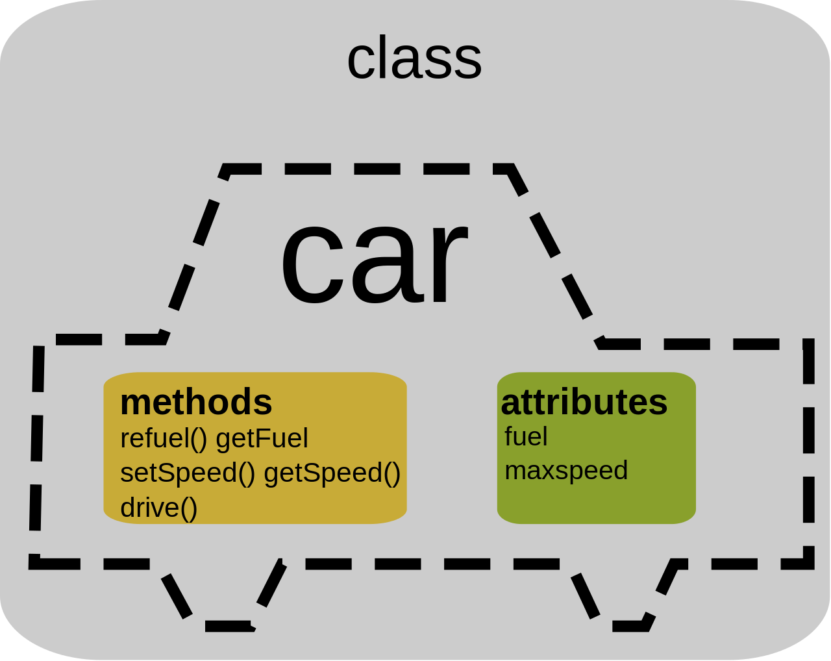

Slide 54
Introduction to Classes
A class is a blueprint for creating objects.
Objects are instances of classes.
class Dog:
def __init__(self, name, age):
self.name = name
self.age = age
def bark(self):
print("Woof!")
# Creating an object of the Dog class
my_dog = Dog("Buddy", 3)

Slide 55
Key Components
Attributes
Characteristics or data of an object.
Methods
Functions that operate on attributes.
Constructor
Initializes object attributes when an object is created.
‘__init__’

Slide 56
Defining a Class
Use the class keyword to define a class.
Create a class name, followed by a colon.

Slide 57
Attributes
Attributes store data within an object.
Define attributes within the class using self.

Slide 58
Methods
Methods are functions associated with a class.
They define the behavior of the class.

Slide 59
The Constructor: __init__
The constructor initializes object attributes.
Use the __init__ method to define the constructor.

Slide 60
Class and Object
A class is like a blueprint, while an object is an instance created from the blueprint.
Multiple objects can be created from a single class.

Slide 61
Question - What Is a Class?
What is a class, and how does it relate to objects?
Can you give an example of a real-world entity as a class?

Slide 62
Question - What Is a Method?
What is a method, and how does it differ from an attribute?
Why are methods important in classes?

Slide 63
Question - The Role of the Constructor
What is the purpose of the constructor (__init__) in a class?
How is it used to initialize object attributes?

Slide 64

Inheritance in Python

Slide 65
Introduction to Inheritance
Inheritance is a core concept in OOP.
It enables the creation of new classes based on existing classes.

Slide 66
Introduction to Inheritance
Base (Parent) Class
Inheritance is a core concept in OOP.
It enables the creation of new classes based on existing classes.
Derived (Child) Class
A derived (child) class inherits attributes and methods from the base class.
It can have additional attributes and methods.

Slide 67
Introduction to Inheritance
Extending a Class
Adding new functionality.
The child class can override or extend methods of the parent class.
Code Reusability
Promotes code reusability.
Common functionalities are defined in the base class and inherited by multiple child classes.

Slide 68
Introduction to Inheritance
Types of Inheritance
Single: A child class inherits from a single base class.
Multiple: A child class inherits from multiple base classes.
Method Overriding
Allows a child class to provide a specific implementation for a method inherited from the parent class.

Slide 69
Decorator
What are Decorators?
Functions that modify or enhance the behavior of other functions
Key Characteristics
Syntax
Uses the @decorator syntax before a function definition
Higher-Order Function
Takes a function as an argument or returns a function
Common Use Cases
Logging, timing, authentication, and code modularization

Slide 70
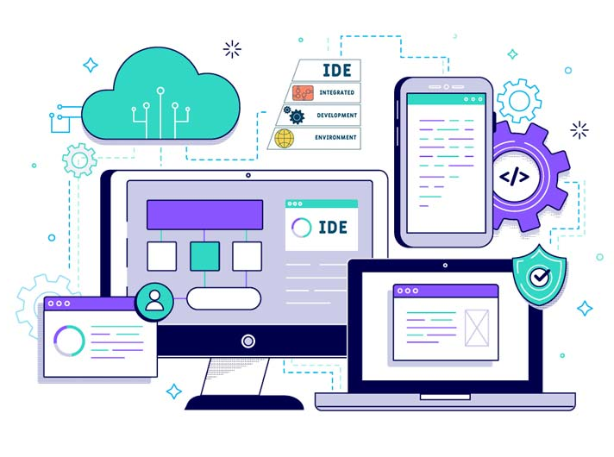
Brief About
IDE

Slide 71
Integrated Development Environment What is an IDE?
Comprehensive software suite for coding and development
Key Features
Code Editor
Text editor with syntax highlighting and auto-completion
Debugger
Tools for identifying and fixing errors in the code
Build Automation
Streamlines the process of compiling and running code
Version Control Integration
Facilities for versioning and collaborative coding
Extensions and Plugins
Customizable with additional tools and functionalities

Slide 72
Integrated Development Environment
Popular Python IDEs
Visual Studio Code
PyCharm
Jupyter Notebooks
Spyder
IDLE (Python's built-in IDE)

Slide 73
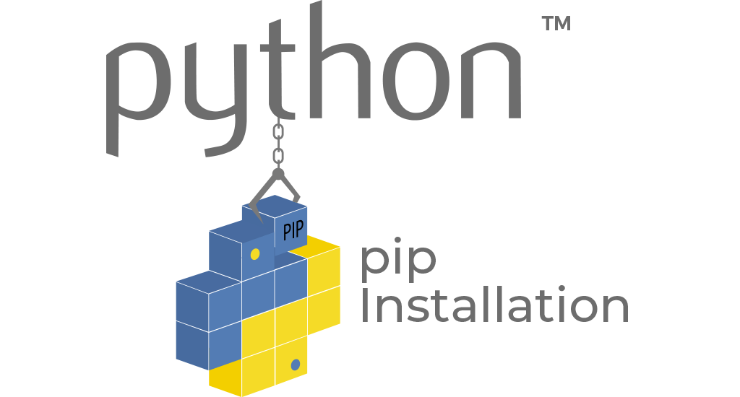

Slide 74
Python Package Installer
What is PIP?
Python Package Installer
Key Functions
Package Installation
Installs external Python packages and libraries
Package Management
Manages dependencies and versions
Virtual Environment Support
Facilitates isolated project environments

Slide 75


Slide 76

Conda Package Manager
What is Conda?
Cross-platform package and environment manager
Key Features
Package Management
Installs, updates, and manages packages and dependencies
Environment Management
Creates and manages isolated environments for projects
Cross-Platform Compatibility
Works on Windows, macOS, and Linux
Extensive Package Repository
Access to a vast collection of pre-built packages

Slide 77
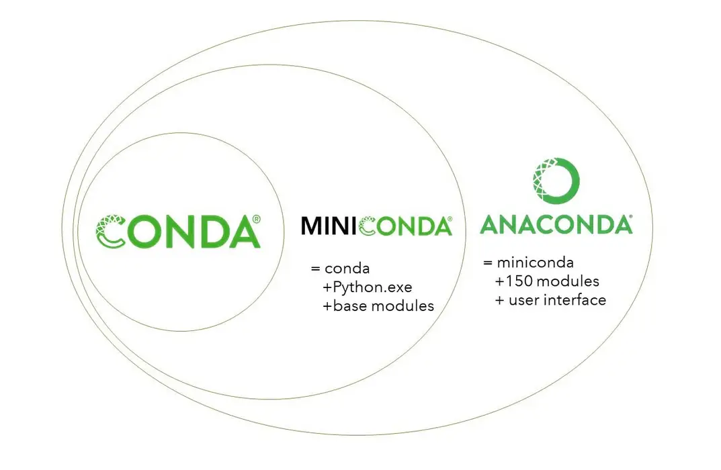

Slide 78


Slide 79
Python interactive interpreter
What is the Interactive Interpreter?
Command-line interface for executing Python code interactively
Key Features
Immediate Feedback
Executes code line by line, providing instant results
Quick Testing and Experimentation
Ideal for testing small code snippets or exploring functionality
Built-in Help System
Access help and documentation directly from the console

Slide 80
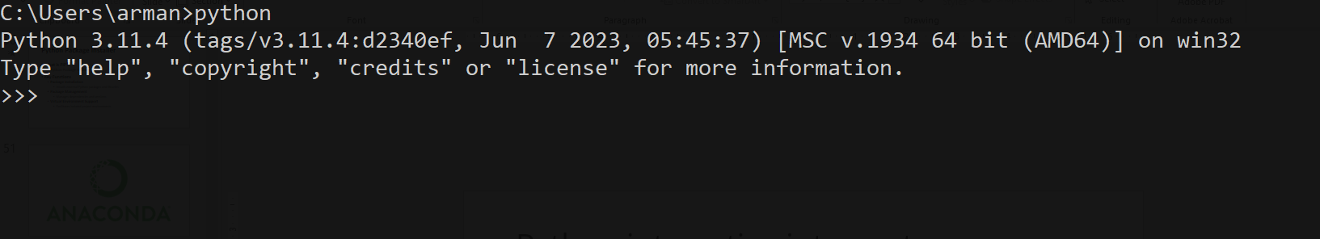
Python interactive interpreter
Accessing Interactive Mode
Open a terminal or command prompt
‘python’ or ‘python3’
Exiting Interactive Mode
‘exit()’ or CTRL+D

Slide 81
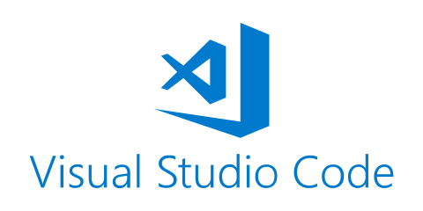

Slide 82
Visual Studio Code VS Code
What is VS Code?
Free and open-source code editor developed by Microsoft
Key Features
Intelligent Code Editor
Syntax highlighting, auto-completion, and error checking
Integrated Debugger
Built-in debugger for efficient code debugging
Extensions Marketplace
Vast library of extensions for customization
Version Control Integration
Git support for versioning and collaboration

Slide 83
Visual Studio Code VS Code
Usage
Download and install from Visual Studio Code website
Popular Extensions
Python, GitLens, Bracket Pair Colorizer, etc.

Slide 84
Virtual Environments VENV
What is a Virtual Environment (VENV)?
Isolated Python environments for managing dependencies and project configurations
Key Functions
Isolation
Keeps project dependencies separate, avoiding conflicts
Dependency Management
Facilitates installation and version control of project-specific packages
Portability
Ensures consistent execution across different environments

Slide 85
Virtual Environments VENV
Basic Commands
Create a Virtual Environment
python -m venv myenv
Activate the Virtual Environment
Windows: myenv\Scripts\activate
Unix or MacOS: source myenv/bin/activate
Deactivate the Virtual Environment
deactivate

Slide 86

Any Questions?

Slide 87
References
Asgharpoor, A. (Fall 2023). "Programming Essentials" Course Material.
Python Official Documentation. Retrieved from https://www.python.org/doc/
GitHub Documentation. Retrieved from https://docs.github.com/en
Kaggle Documentation. Retrieved from https://www.kaggle.com/docs
Jupyter Documentation. Retrieved from https://jupyter-notebook.readthedocs.io/
Real Python. (n.d.). "Python Basics: A Practical Introduction to Python 3." Retrieved from https://realpython.com/python-basics/
W3Schools. (n.d.). "Python Tutorial." Retrieved from https://www.w3schools.com/python/
Stack Overflow. (n.d.). https://stackoverflow.com/

Slide 88
References
VanderPlas, J. (2016). "Python Data Science Handbook." O'Reilly Media.
McKinney, W. (2017). "Python for Data Analysis." O'Reilly Media.
Downey, A. (2015). "Think Python: How to Think Like a Computer Scientist." O'Reilly Media.
Python Software Foundation. (n.d.). "The Python Standard Library." Retrieved from https://docs.python.org/3/library/
Conda Documentation. Retrieved from https://docs.conda.io/
Real Python. (n.d.). "Python IDEs and Code Editors (Guide)." Retrieved from https://realpython.com/python-ides-code-editors-guide/
Real Python. (n.d.). "Python Virtual Environments: A Primer." Retrieved from https://realpython.com/python-virtual-environments-a-primer/
Visual Studio Code Documentation. Retrieved from https://code.visualstudio.com/docs
Images https://www.freepik.com/

Slide 89
Thank you for your time and attention 🙂
A.Asgharpoor1993@Gmail.com
ArmanAsq.GitHub.io
github.com/armanasq

